Slide 1
Digital-twin-enabled 6G: Depth Map Estimation in mmWave systems
Steve Blandino¹, Yeswanth Guddeti²
¹Associate, Communication Technology Laboratory, National Institute of Standards and Technology
²Samsung R&D Institute

Slide 2






Wireless sensing using communication devices
Wireless sensing: the process of acquiring environmental information
Several technologies: camera, radar (e.g. Frequency Modulated Continuous Wave- FMCW), ultra-wideband (UWB), Wi-Fi, 6G.
Advancement in wireless communications and computing.
Wireless sensing can be implemented using everyday consumer electronic devices equipped with a radio.

Slide 3




Integrated sensing and communication (ISAC)
Ensuring Cost and Power Efficiency in Next-Generation Networks
Reuse spectrum and signals to perform both communication and sensing
Smarter devices and new applications

Slide 4





ISAC applications in 6G networks
Health care: vital sign monitoring
In car sensing: driver sleepiness detection
In room sensing: activity/gesture recognition, human presence
Automation: robots/drones
3D vision: Environment Mapping

Slide 5

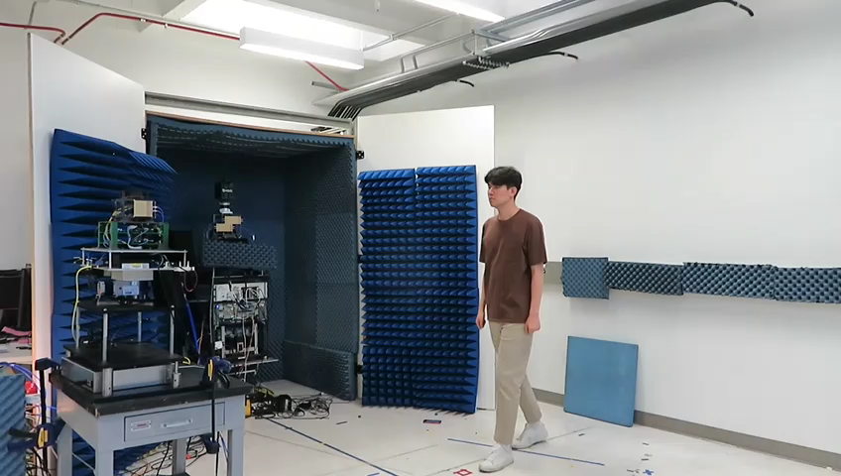

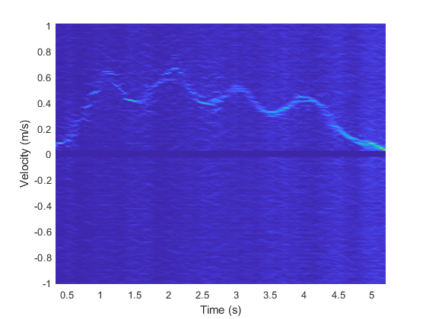
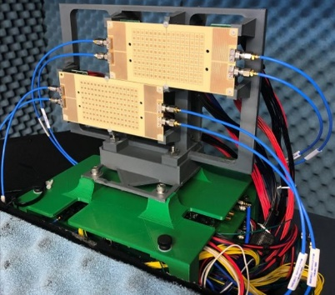
Communication waves to see the physical world
RX
TX
S.Y. Jun, J. Chuang, D. Caudill, C. Gentile, S. Blandino, N. Golmie, “NIST mmWave Phased-Array Channel Sounder for Human Sensing,” Document IEEE 802.11-21/1675r0, Oct. 2021. https://mentor.ieee.org/802.11/dcn/21/11-21-1675-00-00bf-mmwave-phased-array-channel-sounder-for-human-sensing.pptx.
S. Blandino, T. Ropitault, C. R. C. M. da Silva, A. Sahoo and N. Golmie, "IEEE 802.11bf DMG Sensing: Enabling High-Resolution mmWave Wi-Fi Sensing," in IEEE Open Journal of Vehicular Technology, 2023.

Slide 6
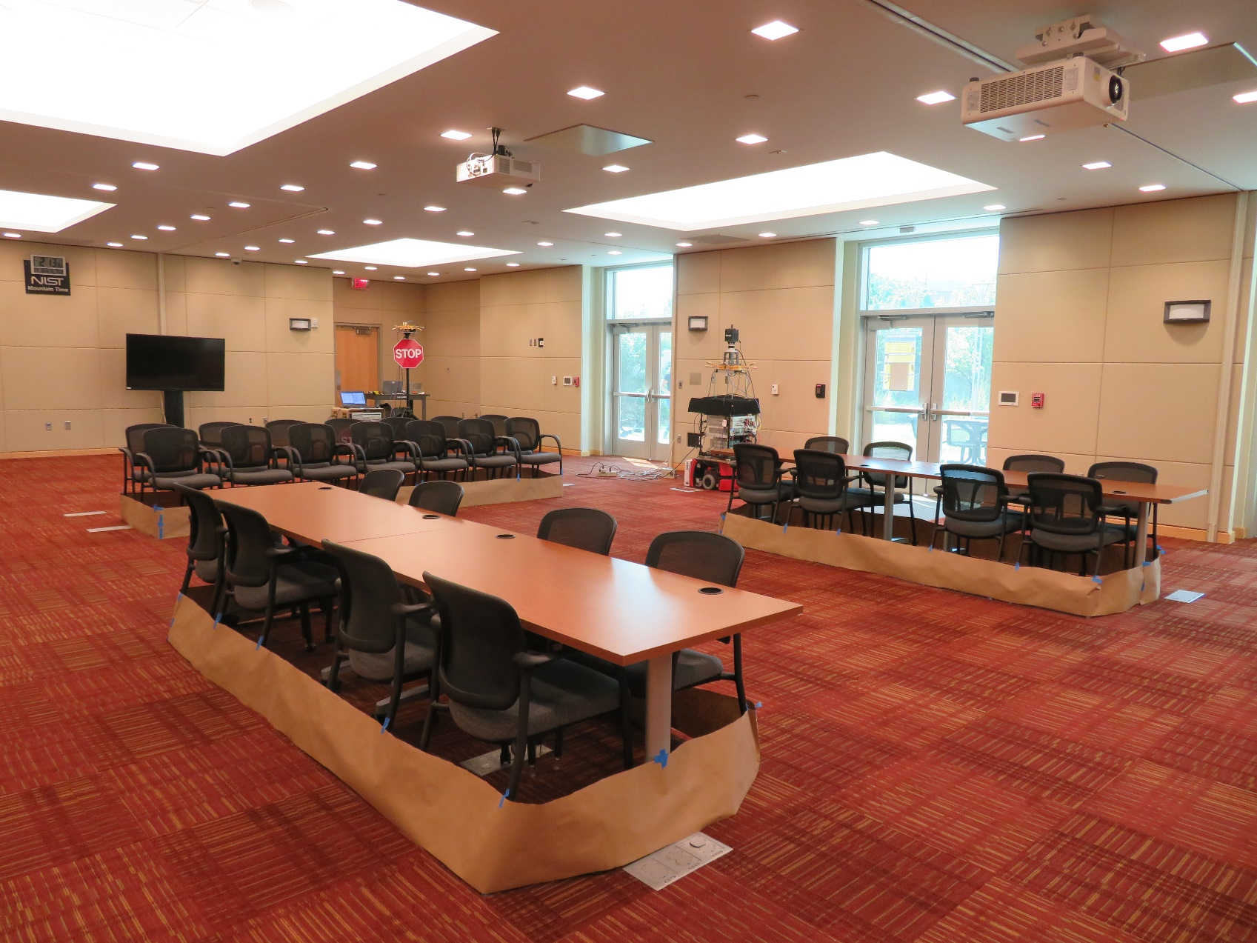
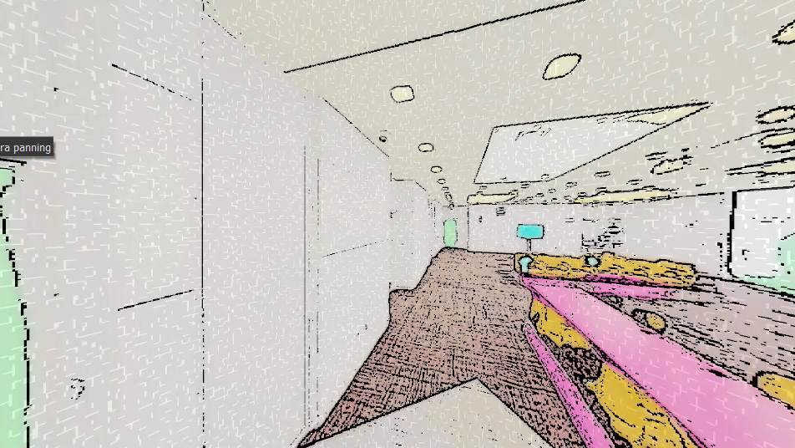
Communication waves to create a digital twin
Physical world
Digital twin
ISAC + AI/ML

Slide 7
Physical solutions in the digital twin
Physical world
Digital twin
ISAC + AI/ML
Inference
Simulation, verification, prediction, control…

Slide 8
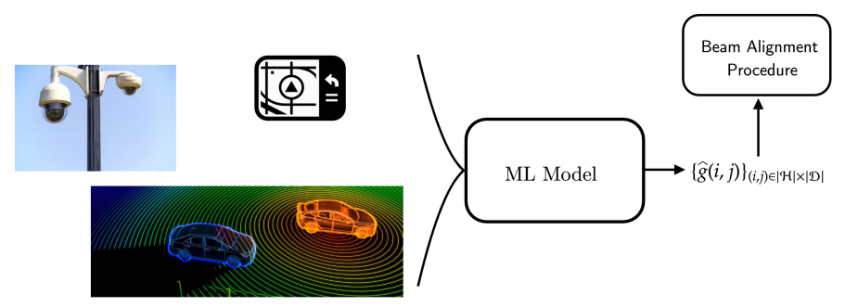
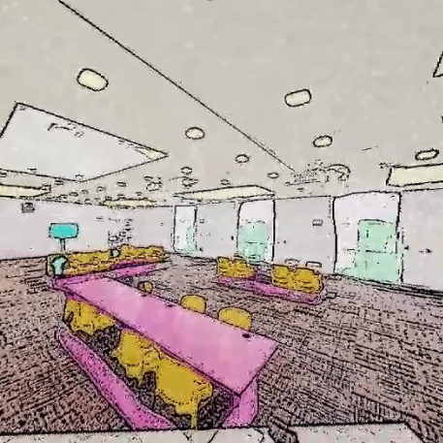
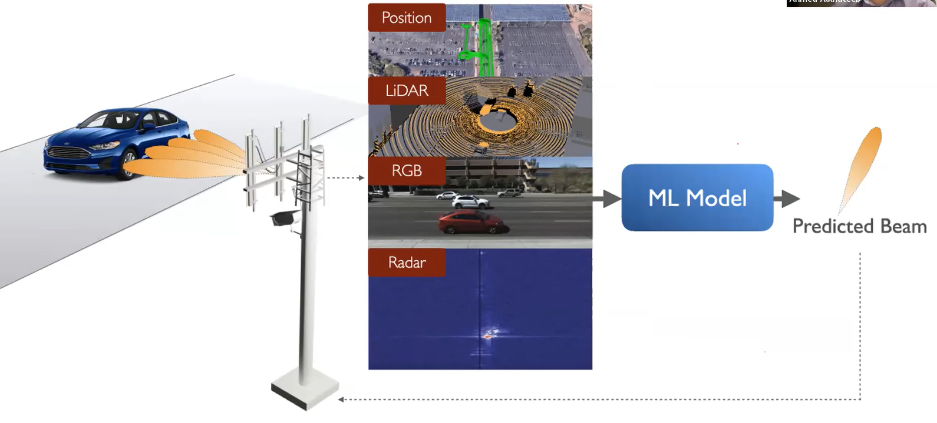
Example: beam selection at millimeter wave
Traditional RF
Sensor Networks + AI/ML
ISAC Networks + AI/ML
Physical world
Digital world
SSW
AI-Aided mmWave Beam Selection for Vehicular Communication, ITU AI/ML in 5G 2020
SSW
SSW
SSW
SSW
Multi-modal sensing aided beam selection, ITU AI/ML in 5G 2022
SSW

Slide 9








Acquiring multi-dimensional information
Sensor Networks
Integrated Sensing And Communication (ISAC)
IOT
Native multi-dimensional data
Extra hardware investment and power consumption.
Not scalable over large networks.
Source of a massive amount of data
Re-using same hardware and spectrum
Extra processing required to acquire multi-dimensional data

Slide 10
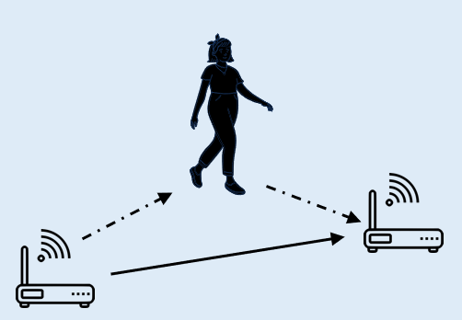
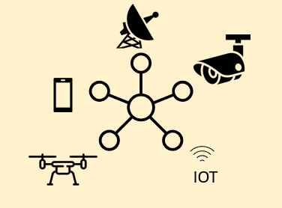
Sensor data to design AI/ML models
Inference using RF communication signal
AI/ML model
Training AI/ML Models using sensors and RF communication signals
Prediction

Slide 11
NIST Measurements

Slide 12
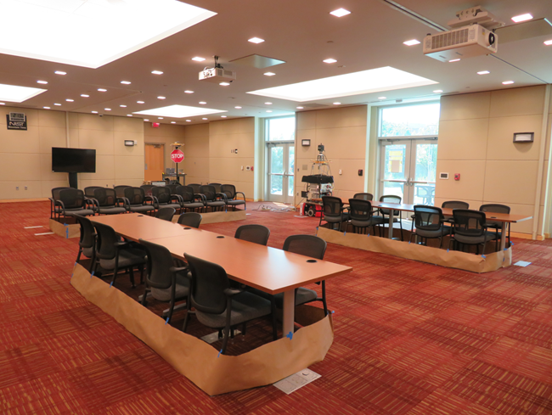
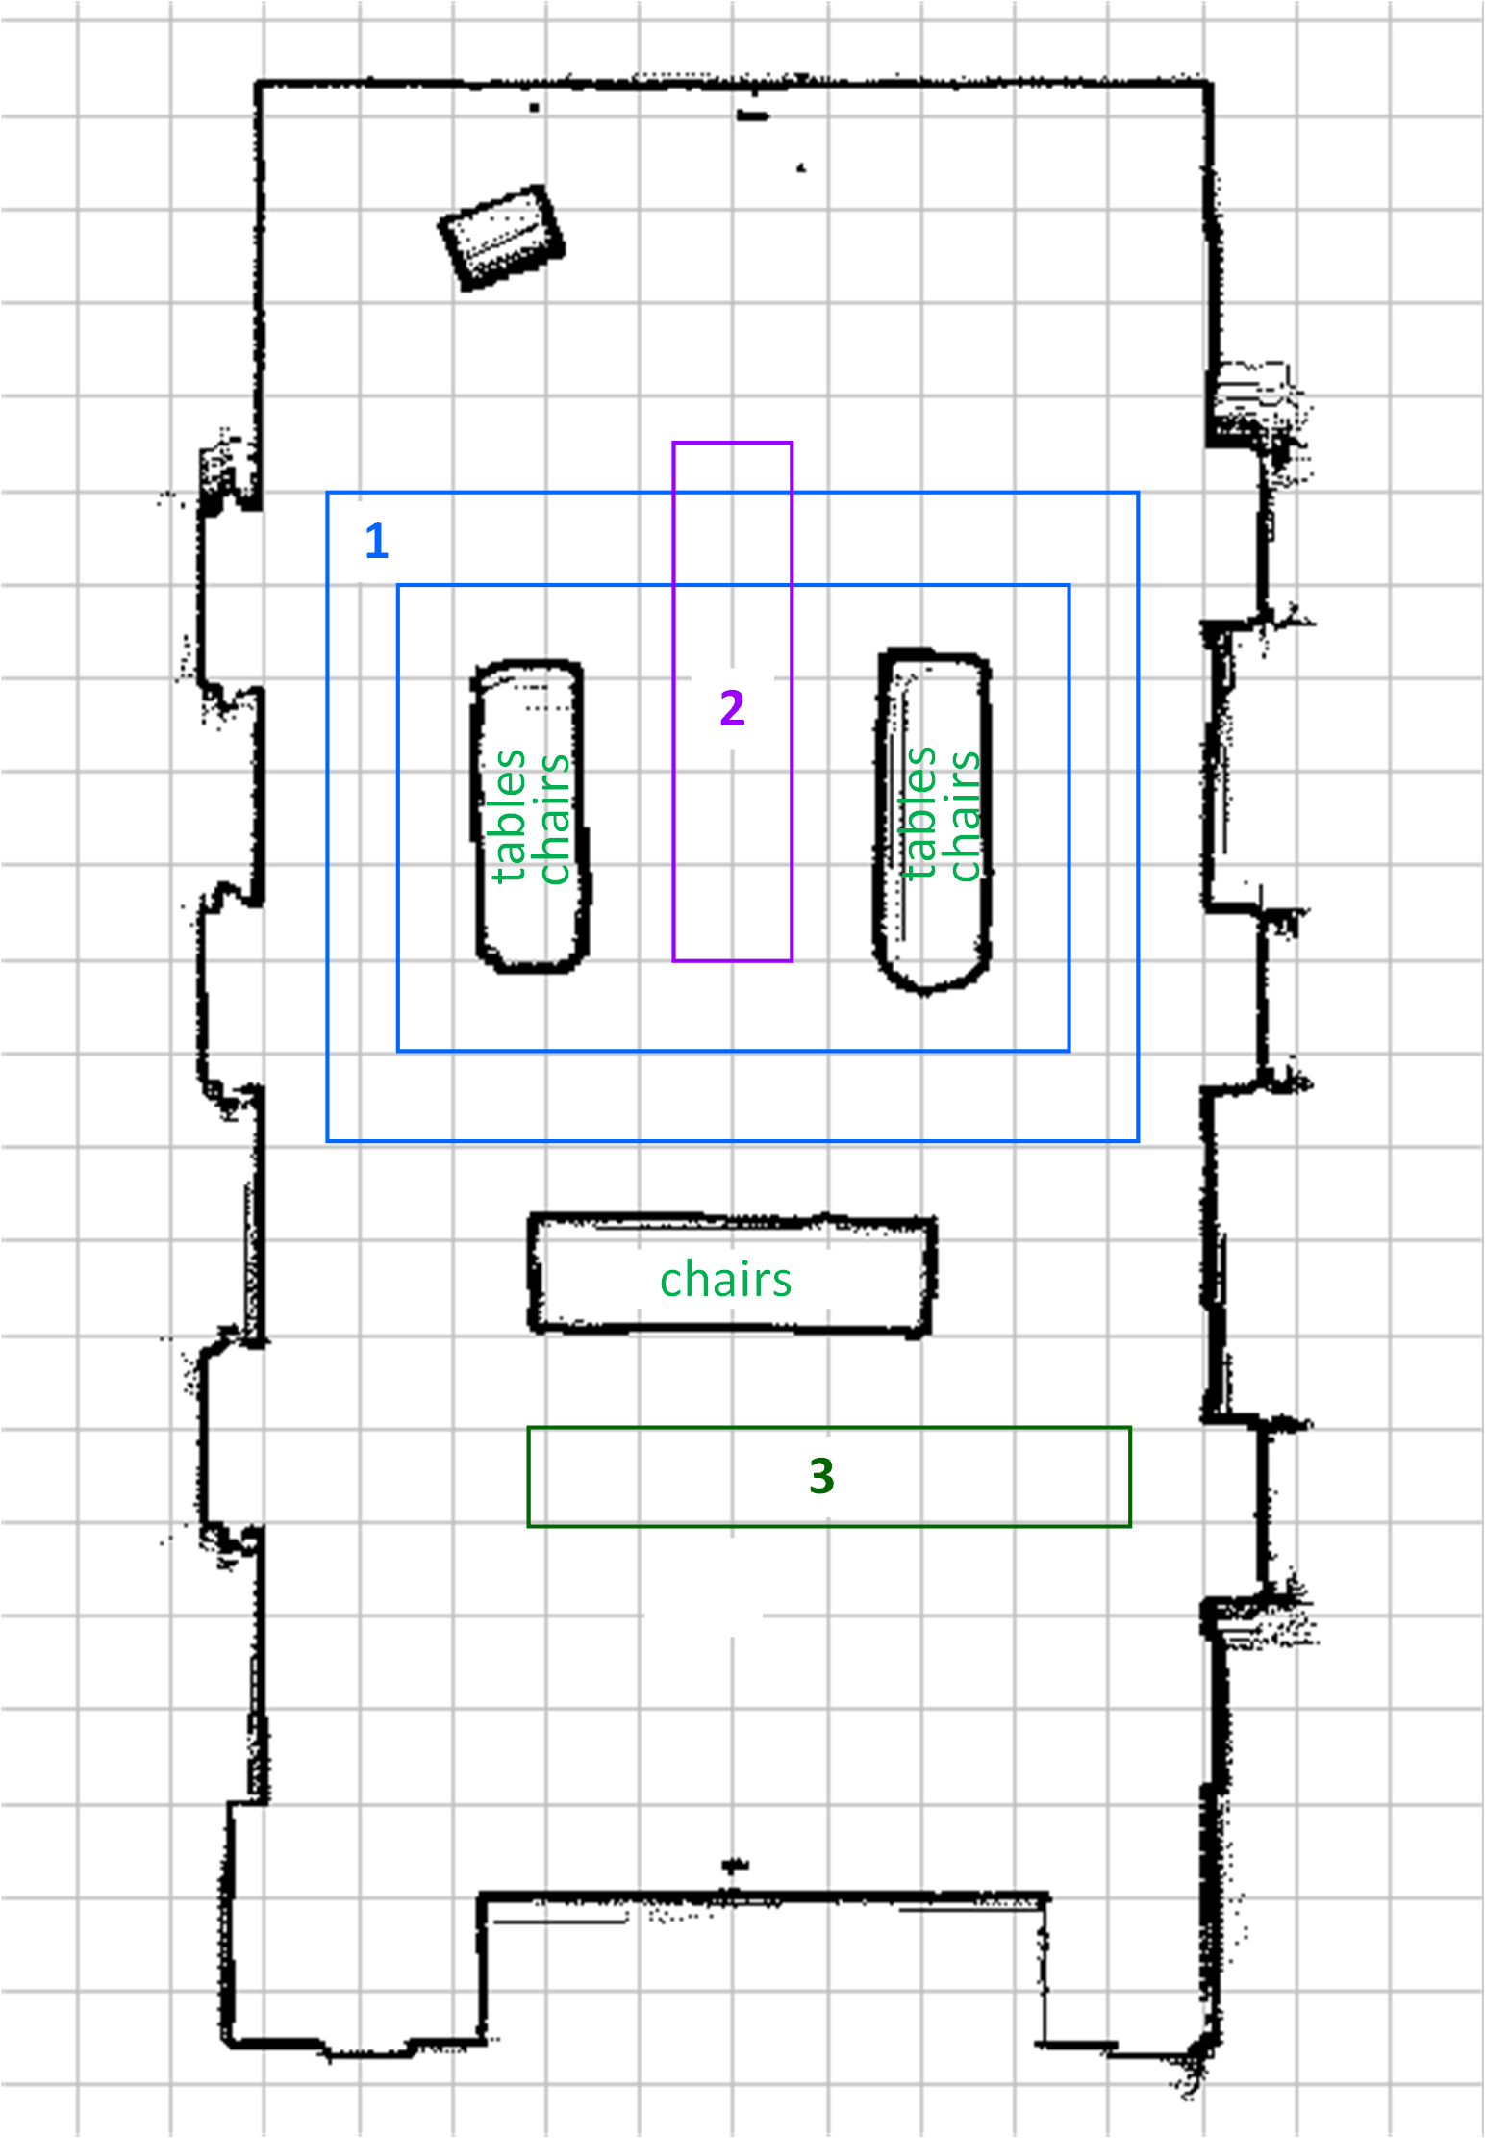
Measurement Environment
Receiver trajectory
Receiver trajectory 1
Receiver trajectory 2
Receiver trajectory 3
Receiver
trajectory
Transmitter
Receiver
Transmitter
The transmitter was fixed in the corner of the room, while the receiver was moving in three areas across the room.

Slide 13

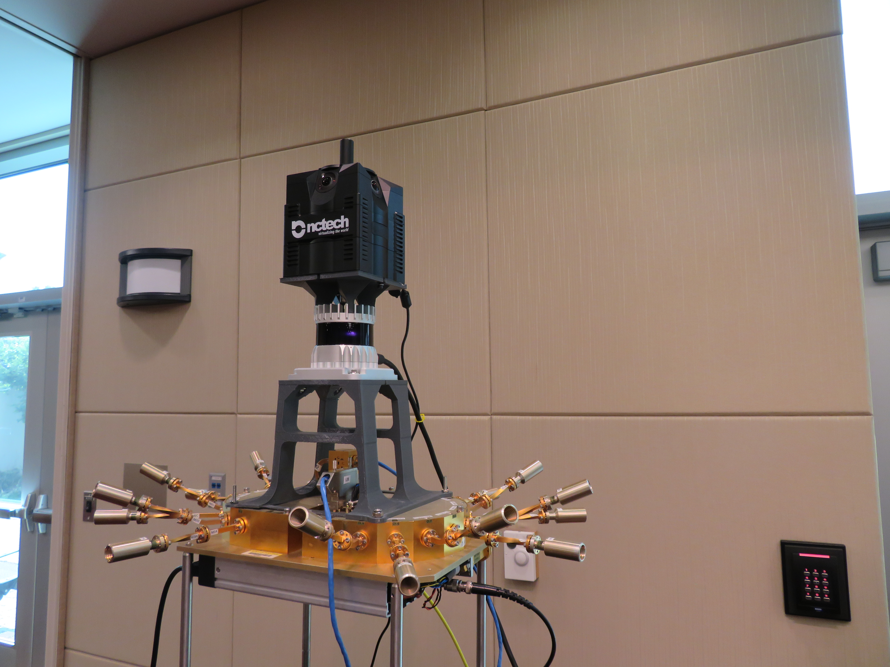
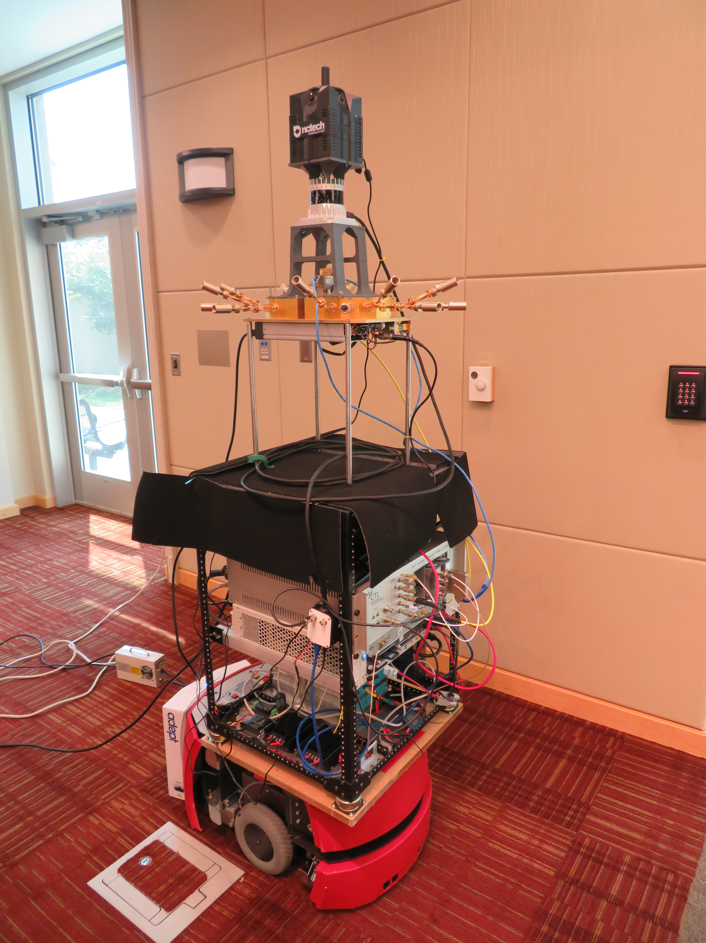
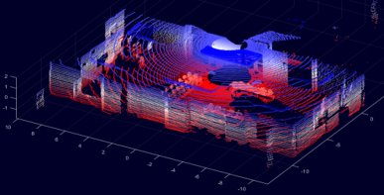
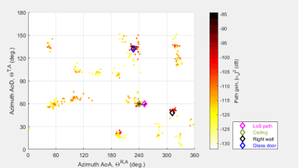
Measurement System & Data Collection
360° Camera
360° Lidar
Antenna array (RF)
While in motion, the receiver collected:
RF data
360° lidar data
360° photos of the environment.
Receiver

Slide 14
ITU AI/ML in 5G challenge

Slide 15

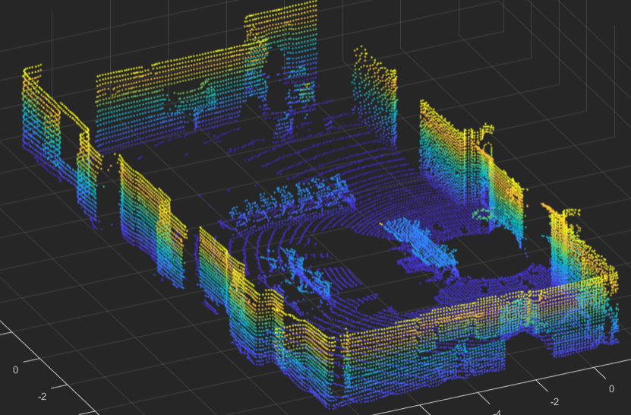
Depth Map estimation using mm-wave+ML
Two MIMO nodes
One fixed transmitter
One moving (position and orientation) receiver
Observation of environment changes over time
Relative to position and orientation of the receiver
Challenge: estimate the depth map of the environment at each receiver position, using mm-wave signals.
Physical world
Digital twin

Slide 16
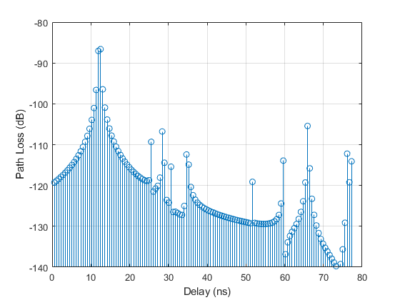
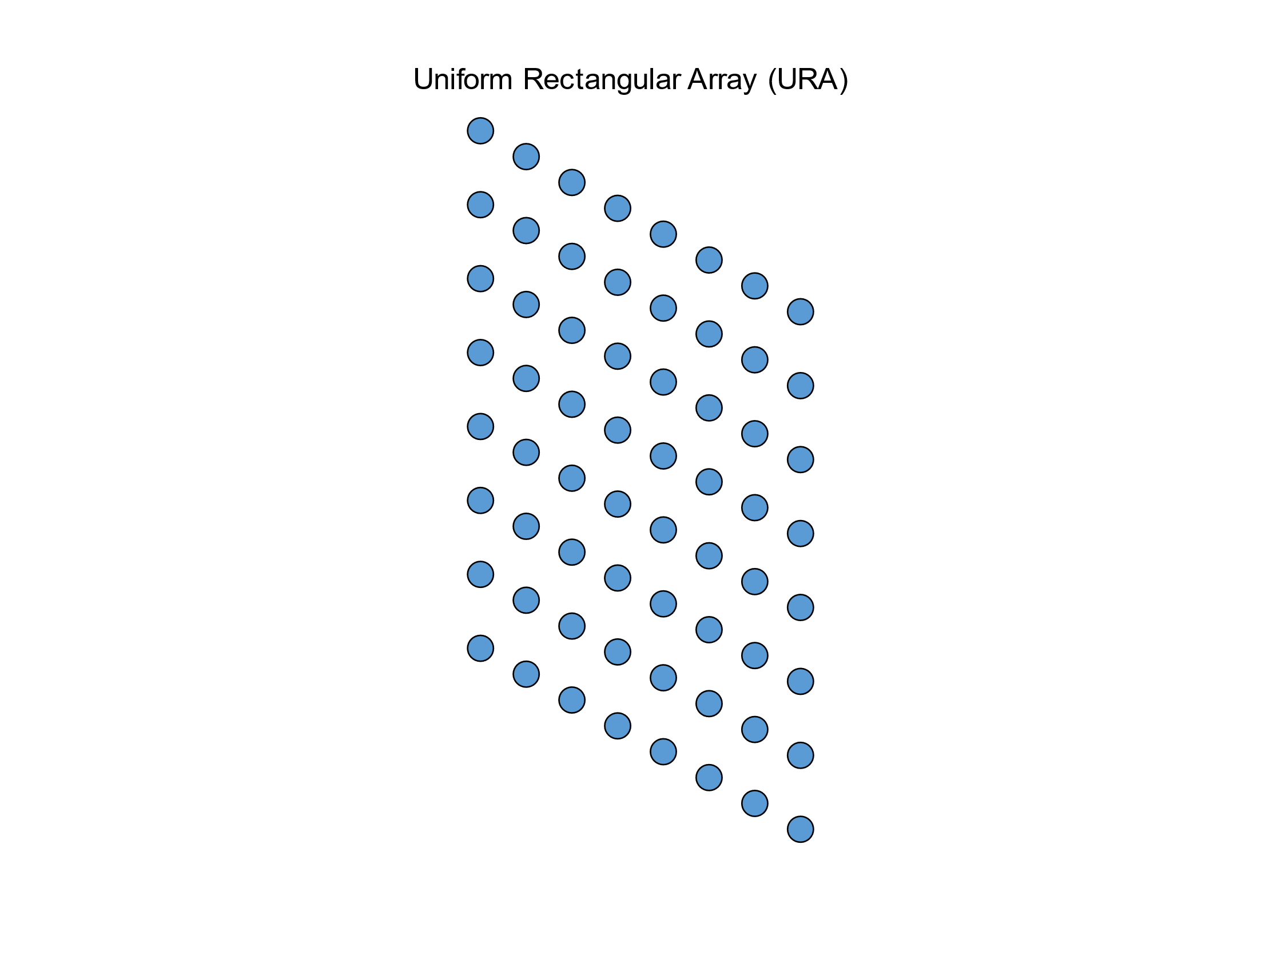

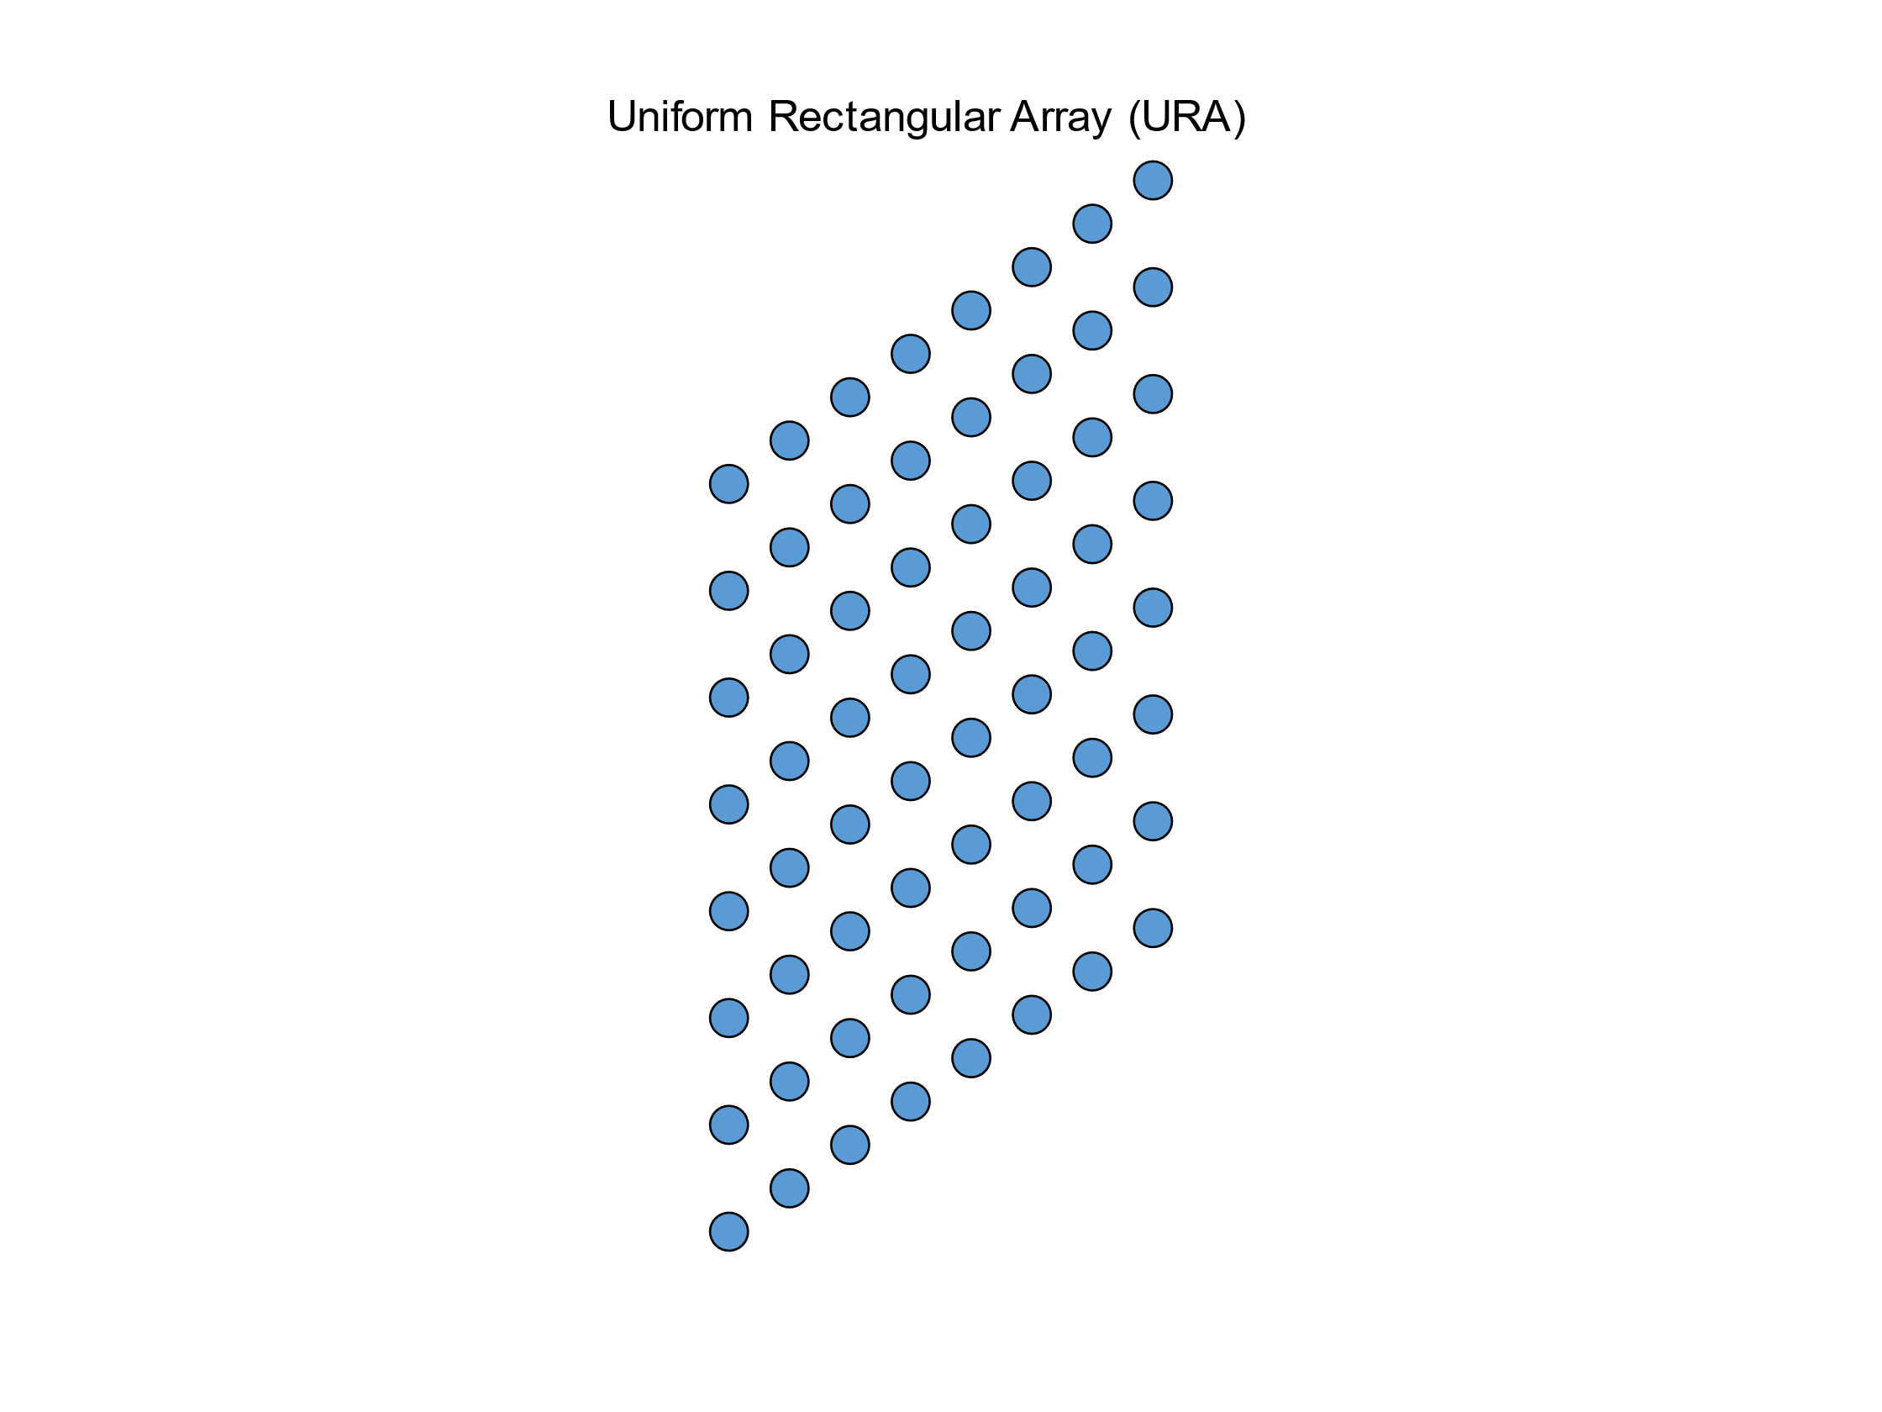
MIMO channel impulse response
RX
8×8
TX
8×8

Slide 17
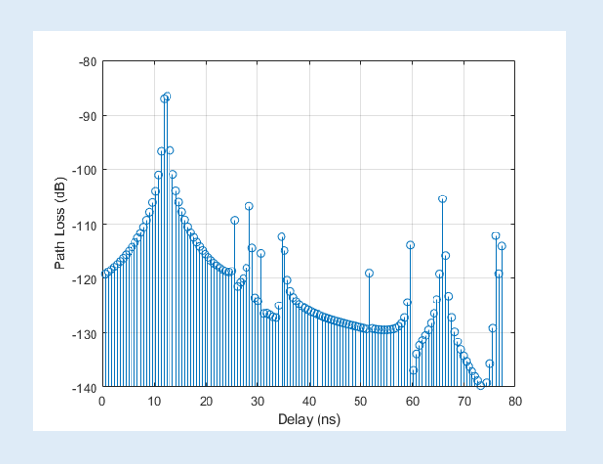
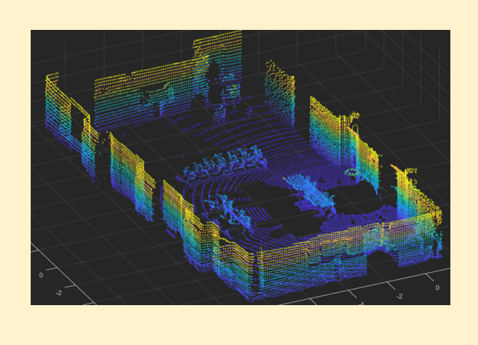
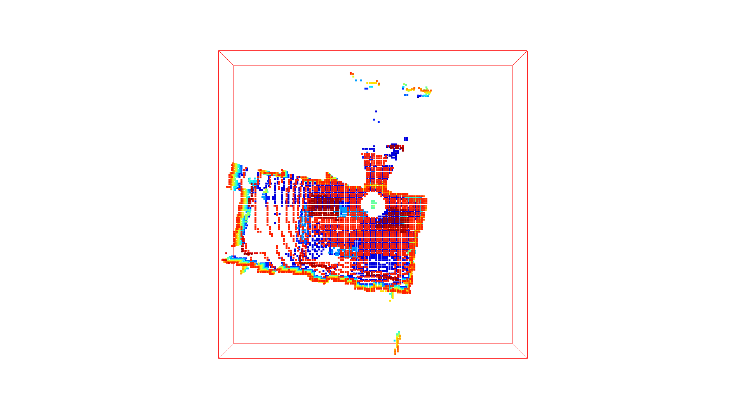
Training the model
Inference using MIMO channel
AI/ML model
Training AI/ML Model using LIDAR data
and MIMO channel
Prediction

Slide 18
Evaluation of the model
Inference using MIMO channel
AI/ML model
Training AI/ML Model using LIDAR data
and MIMO channel
Prediction
Ground truth
Evaluation

Slide 19
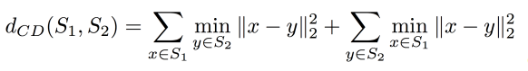


Evaluation metric: Chamfer Distance
Chamfer Distance measures discrepancies between point clouds.

Slide 20
DataSET and File format

Slide 21
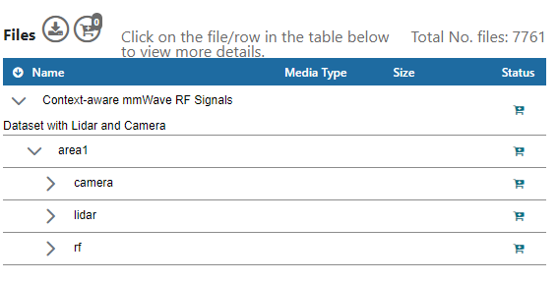
Dataset
Training dataset (Area1, Area3): "Context-aware mmWave RF Signals Dataset with Lidar and Camera"
Dataset website: https://datapub.nist.gov/od/id/mds2-2645
Challenge and dataset related code @GitHub: https://github.com/usnistgov/ML5G-PS-004
File Naming:
FileTypePrefix_<X*10^6+Index>.ext, where FileTypePrefix refers to the type of the file, X is area number, Index=[0, 1, 2, ….., N-1], N is number of cases, and ext is the file extension (mat, pcd, jpg).
File Naming | Description | Values
FileTypePrefix | type of the file | Image, LidarFrame, CIR
X | Area number | 1,2,3
Index | Receiver position | 0, …, N-1
ext | File extension | Jpg, pcd, mat

Slide 22
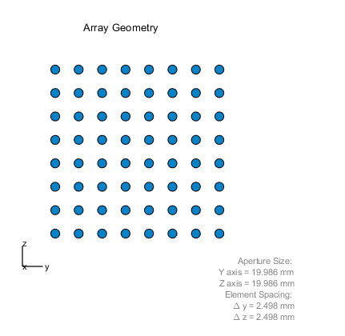
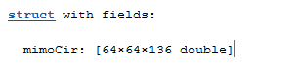
RF data file format
Multiple Input Multiple Output (MIMO) Channel Impulse Response (CIR) format: .mat
8 × 8 Tx and Rx phase antenna arrays
Rx antennas × Tx antennas × Delay taps
Delay sampled at 1.76 GHz
Columnwise reshape of CIR

Slide 23
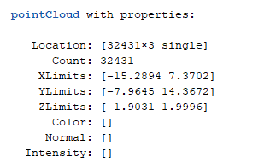
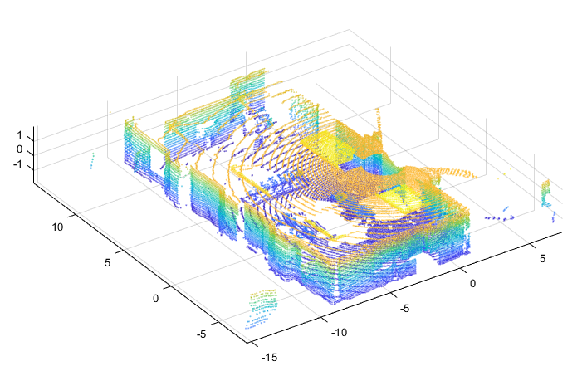
Lidar file format
Lidar type: Ouster OS0-128
Point cloud file format: PCD (binary) https://pointclouds.org/documentation/tutorials/pcd_file_format.html
Point cloud data format: Unorganized and downsampled
Datatype: Single (f32)
How to read point cloud data:
MATLAB* ( recommended 2020b or newer)
Python, e.g. Open3d and pyntcloud
Example:
*Certain commercial equipment, instruments, or materials are identified in this paper in order to specify the experimental procedure adequately. Such identification is not intended to imply recommendation or endorsement by the National Institute of Standards and Technology, nor is it intended to imply that the materials or equipment identified are necessarily the best available for the purpose.

Slide 24
Evaluation
Ranking: based on average (over different positions) Chamfer Distance

Slide 25
Beat the Baseline solution!
Solution provided by 2022 team SixG_ISAC
Samsung R&D Institute

Slide 26
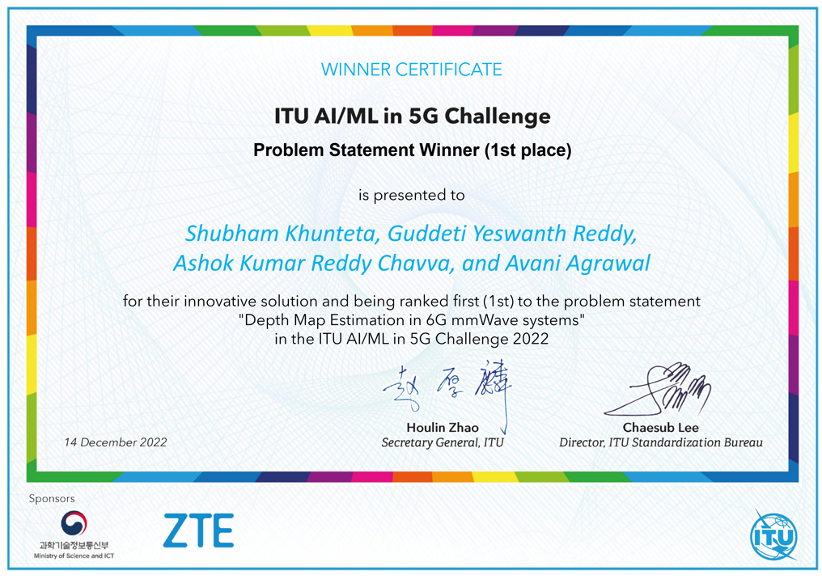
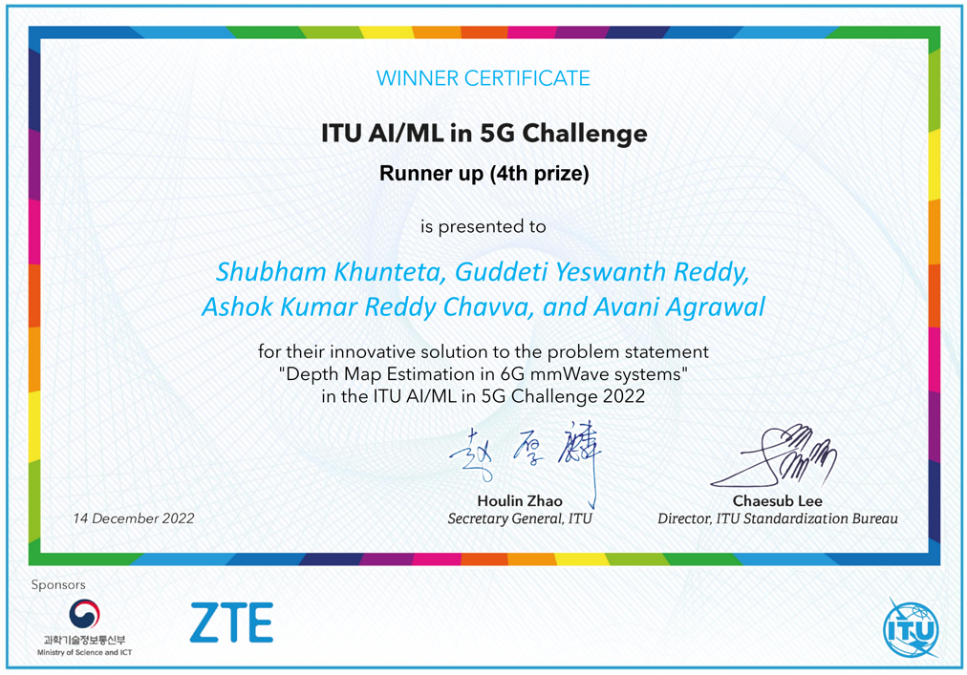
ITU AI/ML in 5G challenge: ITU-ML5G-PS-004
Team Name: SixG_ISAC
Team Github Repo: ITU-AI-ML-in-5G-Challenge/ML5G-PS-004-Depth-map-estimation-in-6G-mmWave-systems
Affiliation : Beyond 5G Team, Samsung R&D Institute India, Bengaluru.
Problem Organizer: NIST, USA.
Notes:
Hello everyone, (hope you enjoyed the presentations so far). I am Yeswanth reddy from Samsung research institute in Bangalore. Our team SixG_ISAC has four members, myself, shubham, avani and ashok .
And we work on applications that go beyond 5G.
To support a large variety of such applications we need a network that is not just fast but also flexible with intelligence to adapt to each of these applications .
In this challenge, Our goal is to develop a machine learning framework for one of these applications i.e estimation of depth map of the environment using 6G communication signals.

Slide 27
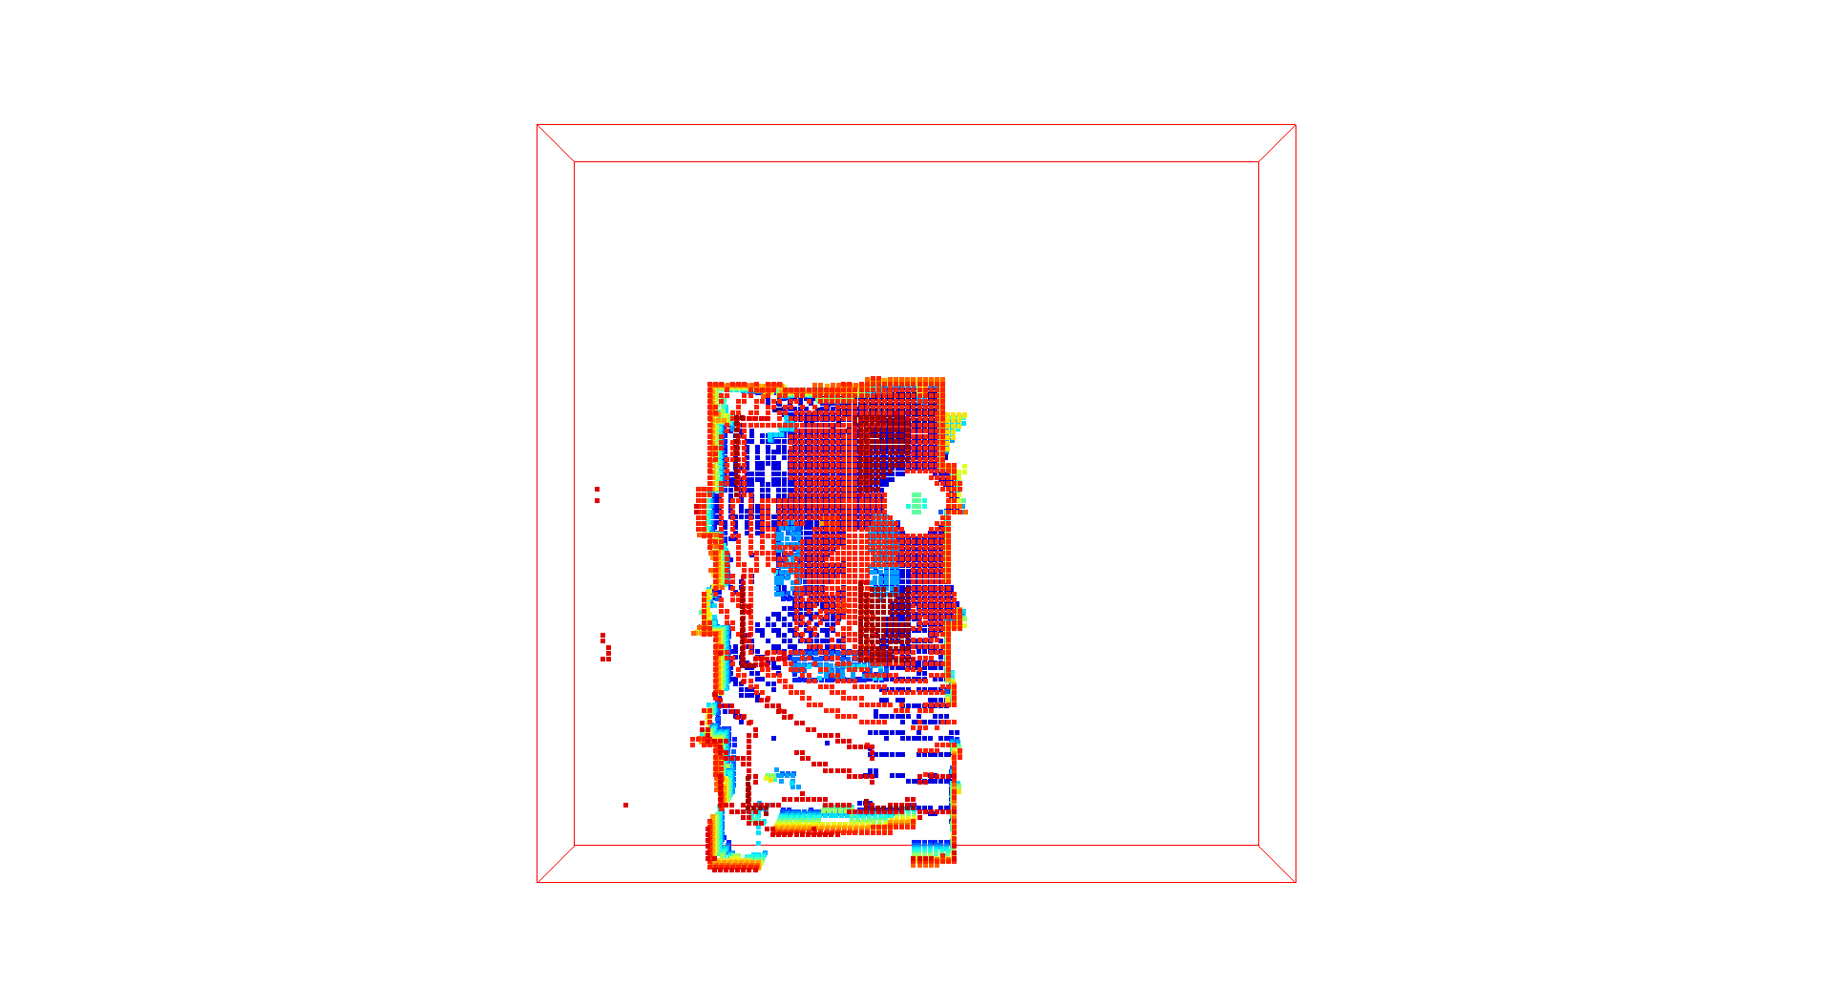
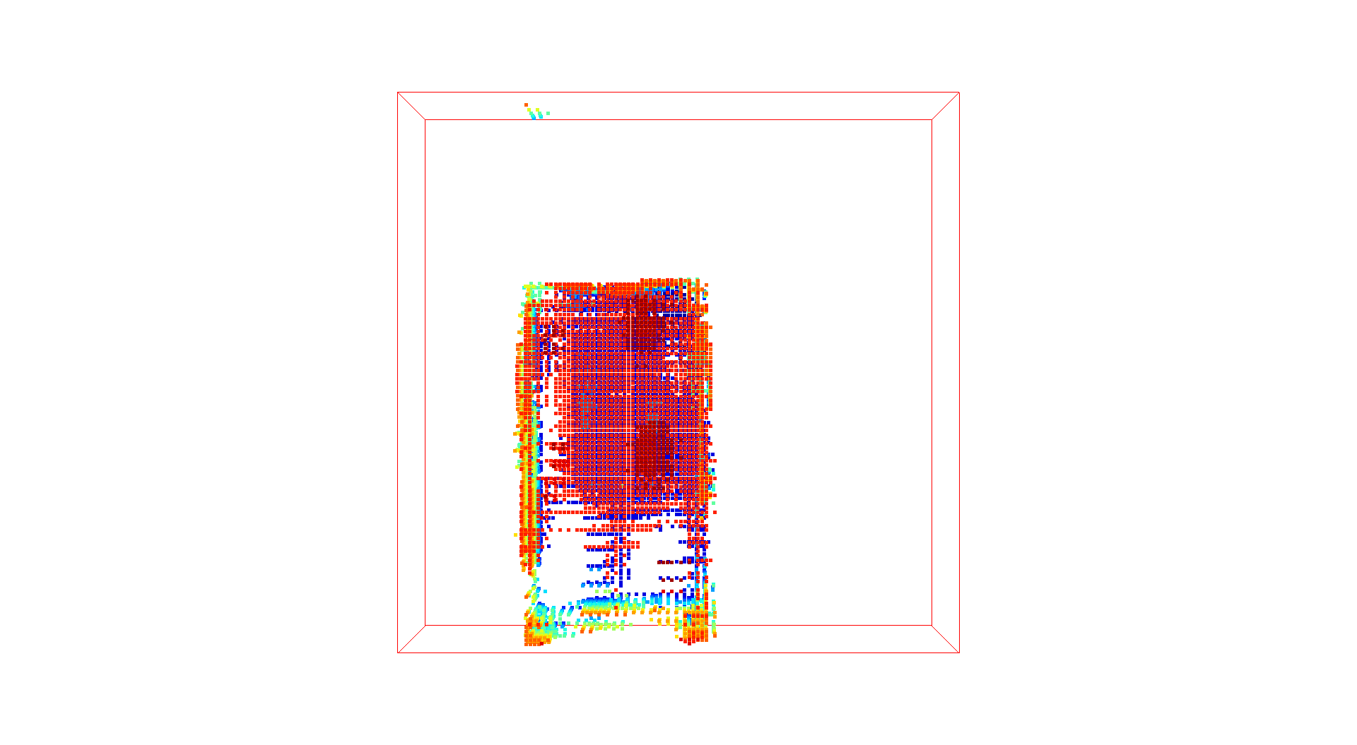
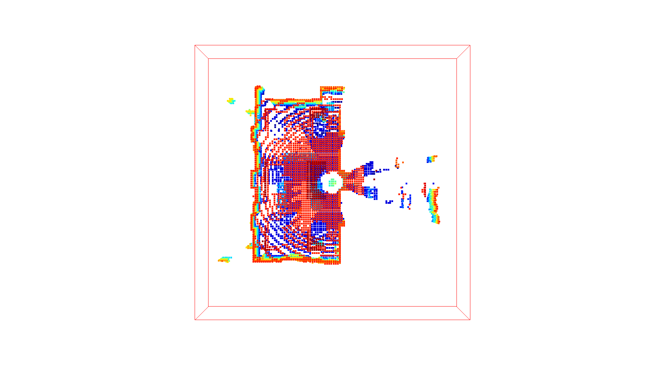
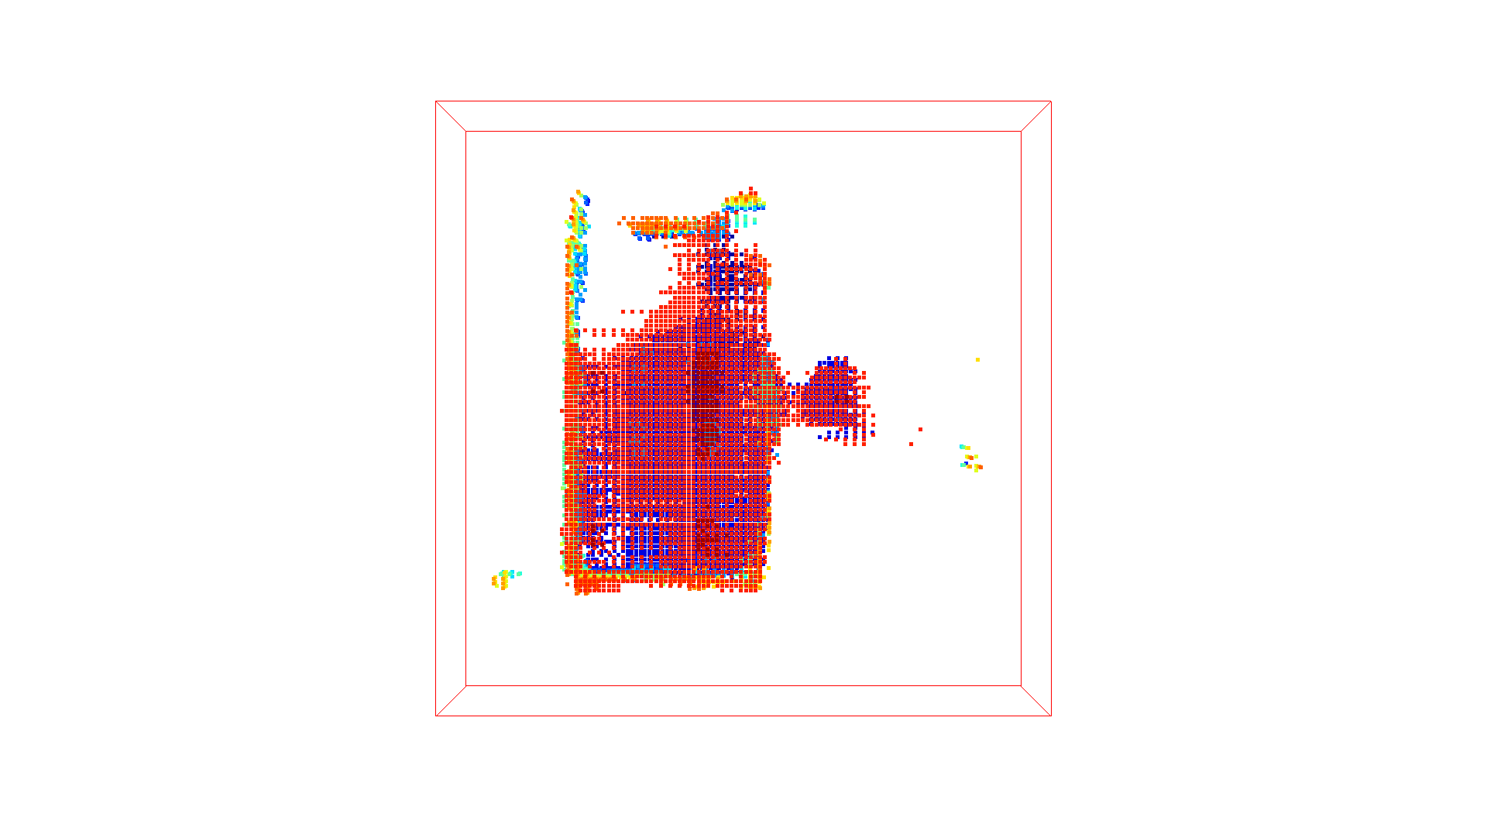
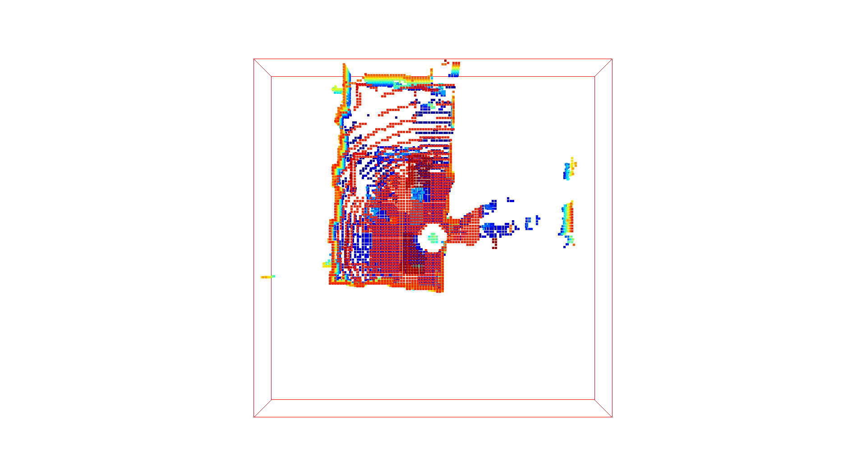
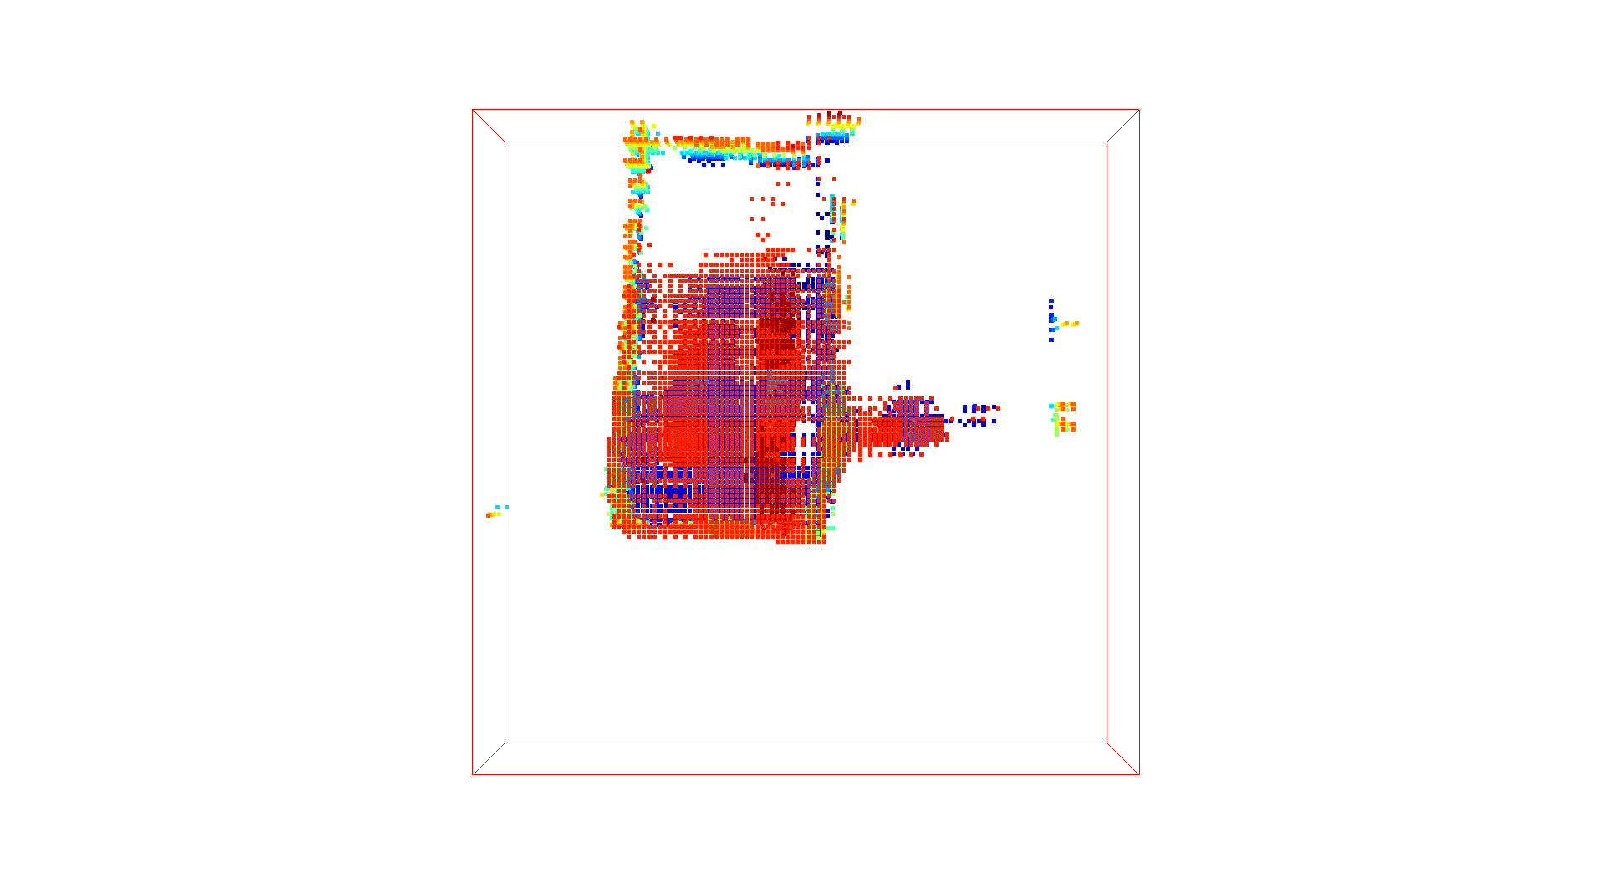
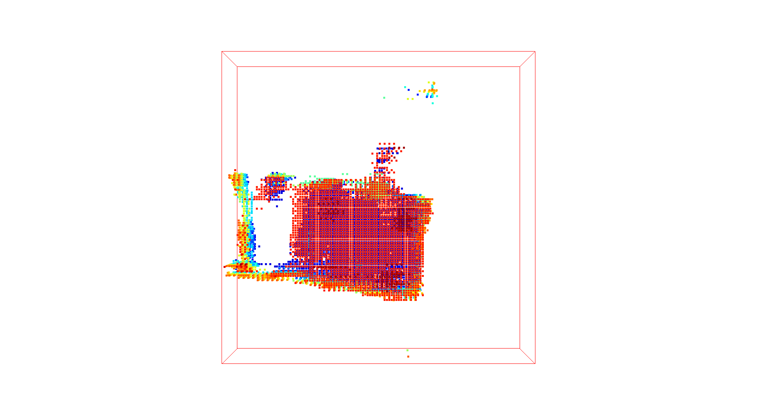
Prediction vs Actual LIDAR PCD
LIDAR PCD (Ground truth) | Predicted PCD
LIDAR PCD (Ground truth) | Predicted PCD
(16, 16, 2)
(16, 16, 2)
(-16, -16, -2)
(-16, -16, -2)
(16, 16, 2)
(16, 16, 2)
(-16, -16, -2)
(-16, -16, -2)
The ML model proposed returns LIDAR-like high resolution point clouds
Change in perception, is nicely captured even though the Tx and Rx locations are unknown.
Notes:
Here are some snapshots of the Actual LIDAR PCD and predicted PCD, we can see that the
The ML model proposed returns LIDAR-like high resolution point clouds
Change in perception across location and orienatation, is nicely captured in the predicted PCD even though the Tx and Rx location is unknown for the challenge.

Slide 28
Problem statement
Problem statement
RX
Setup :
One fixed transmitter
One moving receiver
TX
ML Model :
Channel Impulse response
TX/RX
Location & Orientation Unknown
Input Data:
Training RF Dataset
Trained Model
Output: LiDAR Point Clouds
Challenge : Estimate the depth map of the environment at each receiver position, using mm-wave signals + ML.
Notes:
Lets take a look at the measurement setup. This is the room in which measurements are taken. (laser pointer)
We have a transmitter at a fixed location on the left and a receiver moving in different areas of room . Observation of the room changes with receiver location & orientation -----Transition------
The challenge is to estimate depth map of the environment at each receiver position using mmwave signals.
-----Transition------
In other words , We train an ML model that takes MIMO channel impulse response as input and generates Lidar point cloud as the output.
-----Transition------
Note that We are only given channel impulse response as input. The location & orientation of these nodes are therefore unknown making the problem more complicated.

Slide 29
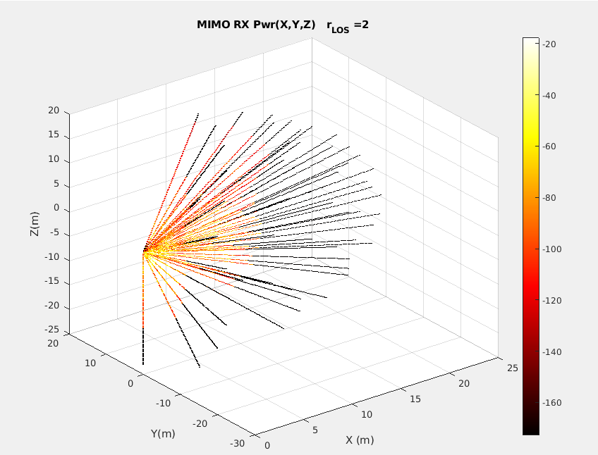

Solution outline
Input Data:
Training RF Dataset
Pre-processing
TX
RX
RX
ML Model
Ground Truth:
Training LiDAR dataset
TX/RX
Solution : At each RX location
Transform bi-static RF data to mono-static format.
Train ML model by fitting it to similarly structured LiDAR ground truth.
Notes:
Now coming to outline of solution.
The input RF data has the transmission & reception at physically seperate locations also known as bi static mode. Whereas Lidar sends and receives laser signals from the same location also known as mono-static mode.
-----Transition------
So Pre-processing step handles the deterministic aspects of transforming MIMO channel data which is in bistatic format to mono-static format. This makes ML model learning faster & understandable.
-----Transition------
Looking at the input data at each location, we observed
that RF data has lower resolution & fewer reflections (with 6400 points) whereas Lidar has both higher resolution & larger points of reflections (approximately 32,000 points).
-----Transition------
So at each RX location,
We transform the bistatic RF data into mono-static format
And train the ML model by fitting it to similarly structured Lidar ground truth.
--------end--------------
As you can see,
In essence, we are attempting to take MIMO channel data that is bi-static (physically separable TX, RX) and fit it to LIDAR data that is mono static (same antenna as TX & RX).
(Why do you need to transform to mono static data before sending to ML?
We wanted to make the training part of model more simpler & explainable . If not done, model should be itself learn about existence of MIMO TX and its location and other features thorough a large amount of training data which is of-course not guaranteed and depends on ML architecture.)
(In addition, we wanted to handle the deterministic aspects of model fitting like data transformations outside the DL model training.
Since we are aware of what part of model learns what? this makes improving the overall model with further additional features much easier.)

Slide 30
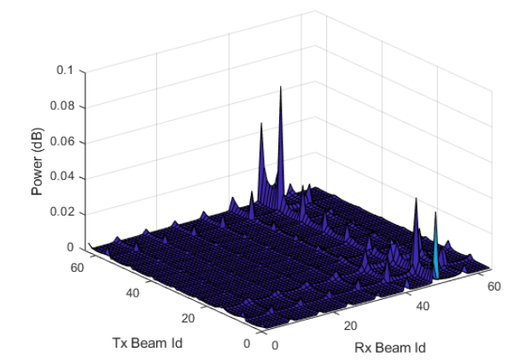
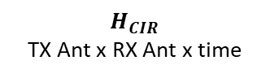
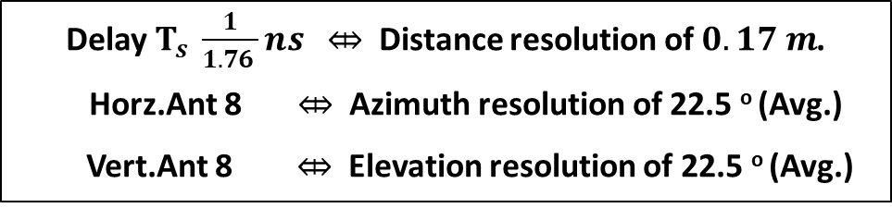


Pre-processing : Spatial Transform
Channel Impulse response
8×8
8×8
$$H_{CIR}$$
TX Ant x RX Ant x time
$H_{CIR}$
Spatial transform
$H_{beam}$
(TX Ant x RX Ant x Delay)
(AOD x AOA x Delay)
Delay $T_{s} \frac{1}{1.76 }ns \text{⤄}$ Distance resolution of $0.17 m$.
Horz.Ant 8 $\text{⤄}$ Azimuth resolution of 22.5 º (Avg.)
Vert.Ant 8 $\text{⤄}$ Elevation resolution of 22.5 º (Avg.)
Transforms Communication data to Sensing framework
Notes:
First step in pre-processing to perform spatial transform on the input channel impulse response. This is done so that we can transform our data from Antenna space to angular beam space.
-----Transition------
This spatial transform therefore helps us get to sensing framework from communication framework.
-----Transition------
((laser pointer) On the right , you have a plot of matrix H_beam for a delay where each entry represents power for an AOA,AOD pair)
The matrix H_beam gives us the power of reflections at points separated in distance by 0.17 m or 17 cm & on avg. in angle by 22.5 deg across azimuth & elevation

Slide 31
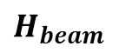

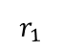
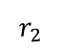
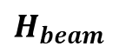
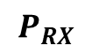

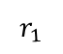
Pre-processing : Spatial Transform
$H_{CIR}$
Spatial transform
$H_{beam}$
$$r_{2}$$
$$r_{1}$$
TX
$H_{beam}$
(AOD x AOA x Delay)
$$r_{1}$$
$P_{RX}$
$$P_{RX}$$
Notes:
Now that we got H_beam, we need to transform it into mono-static format (i.e as if the transmission & reception occur at RX.)
The first step in this transformation is to Find LOS path

Slide 32
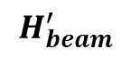
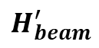
Pre-processing : Find LOS
$H_{CIR}$
Spatial transform
$H_{beam}$
$$r_{2}$$
$$r_{1}$$
1 : Find LOS
TX
$H_{beam}^{′}$
$H_{beam}$
$$H_{beam}^{′}$$
(AOD x AOA x Delay)
Select (TX,RX) Beam with
Higher Power
Lower Delay
Tighter Beamwidth
$$r_{1}$$
$P_{RX}$
$$P_{RX}$$
Remove LOS from $H_{beam}$ & Store LOS parameters
Notes:
(laser pointer) To find LOS , We select the beam which has higher power, lower delay, tighter beamwidth.
------- Transition------
Since the LOS doesn’t have info about environment we remove those entries from H_beam.
But we store the LOS path parameters as they give location & orientation info of RX which will be used in subsequent steps

Slide 33





Pre-processing : Remove TX
$H_{CIR}$
Spatial transform
$H_{beam}$
$$r_{2}$$
$$r_{1}$$
1 : Find LOS
TX
$H_{beam}^{′}$
$$H_{beam}^{′}$$
(AOD x AOA x Delay)
2 : Remove TX
$$P_{RX}^{′}$$
$$r_{2}$$
$$r_{1}$$
$$P_{RX}^{′}$$
$P_{RX}$
(AOA x Delay)
Remove effect of TX by projecting AOD to Delay
Notes:
Next, we remove the effect of TX in the matric H_beam to get power map from RX perspective .
---Transition ---
We do this by projecting AOD dimension to delay dimension

Slide 34










Pre-processing : Remove TX
$H_{CIR}$
Calculate $\frac{r_{2}}{r_{1}}$ $=\frac{\sin\left(ΔΘ_{AoA}\right)}{sin⁡({ΔΘ}_{AoD})}$
Spatial transform
$$r_{2}$$
$H_{beam}$
$$r_{2}$$
$$r_{1}$$
$$r_{1}$$
1 : Find LOS
TX
TX
$$ΔΘ_{AoD}$$
$H_{beam}^{′}$
$$ΔΘ_{AoA}$$
RX
$$H_{beam}^{′}$$
RX
2 : Remove TX
Project AOD to Delay
$$P_{RX}^{′}$$
$$P_{RX}^{′}$$
(AOA x Delay)
Delay
($Θ_{AoA},r_{1})$
AOD
$$r_{1}+r_{2}$$
$$Θ_{AoD}$$
$P_{RX}$
Delay
$$Θ_{AoA}$$
AOA
AOA
Notes:
(laser pointer) The signal shown here (travels r2 distance before hitting an obstacle and then travels r1 distance before arriving at RX ) travels r1+r2 distance from TX to RX. so we need to shift the delay of this entry in H_beam from r1+r2 to r1 so that it appears to arrive at RX directly from reflection point.
SO we need to calculate ratio r2/r1.
----Transition----
(laser pointer) In this triangle made from LOS path and the Current reflection , the angle delta AOD is difference between Angle of departure of LOS and of the current reflection . Delta AOA can be defined similarly. Here we use LOS parameters saved in the previous step.
Applying sine theorem we can obtain the ratio r2/r1 as ratio between sines of delta AOA to delta AOD
Now we can project entries in AOD dimension to appropriate delay to get power map from RX perspective.

Slide 35
Pre-processing : Remove TX
$H_{CIR}$
Spatial transform
$H_{beam}$
$$r_{2}$$
$$r_{1}$$
1 : Find LOS
TX
$H_{beam}^{′}$
$$H_{beam}^{′}$$
(AOD x AOA x Delay)
2 : Remove TX
$$P_{RX}^{′}$$
$$r_{2}$$
$$r_{1}$$
$$P_{RX}^{′}$$
$P_{RX}$
(AOA x Delay)
Remove effect of TX by projecting AOD to Delay
Notes:
In conclusion, we remove the effect of TX by projecting AOD dimension to delay dimension

Slide 36






Pre-processing : Rescale Power
$H_{CIR}$
Spatial transform
$H_{beam}$
$$r_{2}$$
$$r_{1}$$
1 : Find LOS
TX
$H_{beam}^{′}$
$$H_{beam}^{′}$$
(AOD x AOA x Delay)
2 : Remove TX
$$P_{RX}^{′}$$
$${ P}_{RX} =P_{RX}^{′}∗\frac{r_{2}^{2}}{r_{1}^{2}}$$
3 : Rescale power
$$r_{2}$$
$$r_{1}$$
$$r_{1}$$
$$r_{1}$$
$$P_{RX}^{′}$$
$$P_{RX}$$
$P_{RX}$
(AOA x Delay)
(AOA x Delay)
(AOA x Delay)
Rescale to get monostatic power
Notes:
The last step remaining is to scale the power so that the reflections appear to travel the Receive path twice.

Slide 37



Pre-processing :
$H_{CIR}$
Input: CIR for 64x64 MIMO
$$r_{2}$$
$$r_{1}$$
Spatial transform
TX
$H_{beam}$
1 : Find LOS
$$H_{beam}^{′}$$
2 : Remove TX
$$P_{RX}^{′}$$
3 : Rescale power
Z (m)
$$r_{1}$$
Y (m)
$$r_{1}$$
X (m)
$P_{RX}$
Notes:
With this, we have finished pre-processing where we have taken channel impulse response in bi-static format as input and obtained RX power which is in mono-static format similar to lidar as output
Now it’s ready to be sent to the ML model.
--Transition---
The plot shows pre-processed data for a single RX location. We see power at RX. across 64 different AOAs and 100 delays in each of AOA.
Shubam will now explain the ML model and results of training.

Slide 38



Input and Output for ML Model Training
Given Input: CIR for 64x64 MIMO
Given Output (ground truth): LIDAR PCD
(16, 16, 2)
RX
~ 35k points
[1.233, 8.342, -1.20]
[4.25, 10.57, -0.25] ….
(-16, -16, -2)
(16, 16, 2)
If a point is in voxel: Voxel value =1
Pre-processing
TX
(16, 16, 2)
(-16, -16, -2)
(16, 16, 2)
Z (m)
ML Model
Voxel Grid
Y (m)
X (m)
(-16, -16, -2)
(-16, -16, -2)
Input for the ML model:
Power of reflections from :
64 directions : (8 Az x 8 El)
Each direction 100 points*.
Output labels for ML model: Voxel Grid:
Voxel size =0.25 m -> Dim: 128 x 128 x 16
Voxel size=0.5 m -> Dim: 64x64x8
~ 13k voxels are 1 out of : 128 x 128 x 16 voxels
*Distance between consecutive points ~ 17cm
Notes:
Input:
So far, We pre-processed the input CIR data and obtained the power of reflections at receiver from 64 directions and 100 points in each direction. This is the input for the ML model.
# This translate to 17m of radius as the range resolution is 17cm.
----------
#Output:
- Now, I will explain the output for the ML model
Given output for the challenge is LIDAR PCD of the room as seen by the receiver
#one LIDAR PCD contains ~35k points which are coordinates of obstacles and it looks like this figure
For the ML model training, Input and output data is given for multiple locations across the room.
Perception of the room as seen by Rx changes with the change in Rx location and orientations. And here are some snapshots of output data across locations explaining this behaviour.
Assuming Rx is at origin, we observed, across the locations, LIDAR points are inside of the bounding box with min_bound = [-16, -16,-2] and max_bound=[16,16,2]
So, we use a voxel grid as the output for the ML model with these min and max bounds.
With voxel size =0.25 m, the dimension of voxel grid 128x128x16, if we use voxel-size as 0.5m, the voxel grid size reduces by 8.
#Note that, 35k points of lidar PCD, fits into 13k voxels of voxel grid of voxel-size 0.25m
Higher the voxel size, complexity of the ML model will be lower, but resolution of the output will also be lower , so there is a trade-off !

Slide 39
Solution : Why is it difficult ?
Z (m)
RF
 | Pre-processed RF data | LIDAR Data
Range resolution | 0.17 m | 10^-6 m
Angle resolution | Low (~ 22.5 º ) | High
I/O Dimension | 6400x1 | 2,62,000 voxels (voxel grid: 128x128x16)
Location of the Tx and Rx is unknown
Y (m)
X (m)
ML Model
Lidar
Solution is novel and first of its kind.
Notes:
- Why this problem is so challenging to solve ?
- There have been enough research on camera image as input to depth map estimation and few works on high resolution LIDAR as input and Radio signals as output.
- But Here In this problem we have, more challenging situation where input RF data has way less resolution than the output LIDAR data in terms of range and angle.
because lidar is at higher freq and guided by laser beam, while RF sensing limited by sampling rate and no. of antennas.
Lidar gives more reflections compared to RF sensor.
Here, Input dimension is quite lower than the output dimension (I/o = 3% )
Apart from this, for this challenge, Tx and Rx locations are also unknown.
#Range resolution of the RF data is 0.17 m while that of lidar data is 10^-6 m observed
#Angle resolution of the RF data is also poor (around 22.5 deg) compared to high resolution lidar.

Slide 40
ML model architecture
From Pre-processing step:
Motivation behind used layers:
Up-sampling layer
Ratio I/O dimension=3%
CNN layers:
Correlation in reflections exists in close neighbourhood
Z (m)
Y (m)
X (m)
Notes:
Now, I will explain the ML model
The pre-processed CIR, which is mono-static Rx power is fed to dense layer, followed by Upsampling layer and CNN layers to predict the voxel grid and further, the Point cloud data.
we use upsampling layer becasue I/O dimension ratio is less, ~3% as the input dimension is 6400 and output dimension is 128x128x16,
we use CNN layers because Correlation in the reflections exists in the neighbourhood,

Slide 41

Training parameters
Custom Loss function: binary cross entropy with weights where $w_{1}=10$and $w_{0}=1$.
As the output voxel grid is sparse, training is skewed towards the label ‘1’.
$$L=−\frac{1}{N}\sum_{i=1}^{N}{ \left( w_{1}∗y_{i}\log\left(p\left(y_{i}\right)\right)+w_{0} (1−y_{i}) log\left(1−p\left(y_{i}\right)\right) \right)}$$
~ 13k voxels are 1 out of : 128 x 128 x 16 voxels
Dataset:
Total training samples : 3400 samples
Area 1 : 2400 samples
Area 3: 1000 samples
Validation samples : 350 (consisting of both the areas)
Test data: 529 samples of Area 2
RX
Testing samples
Training samples
Optimizer:
Adam with learning rate of 0.0005
Decay rate: 0.9 every 10000 steps
Epochs =100, batch size : 32.
TX
Notes:
-Coming to training parameters:
We use Custom loss function which is similar to binary cross entropy loss function with added weights for the labels. Higher weight is given to 1 since in the output voxel grid of size 128x128x16, only 13k voxels are 1.
We train the model with 3400 samples captured across various location as shown in the figure.
Testing data consist of CIR for 529 locations.
We train this model with adam optimizer with decaying learning rate of 0.0005.
(2min+30sx3=1.5min=3.5min)

Slide 42
Prediction vs Actual LIDAR PCD
LIDAR PCD (Ground truth) | Predicted PCD
LIDAR PCD (Ground truth) | Predicted PCD
(16, 16, 2)
(16, 16, 2)
(-16, -16, -2)
(-16, -16, -2)
(16, 16, 2)
(16, 16, 2)
(-16, -16, -2)
(-16, -16, -2)
The ML model proposed returns LIDAR-like high resolution point clouds
Change in perception, is nicely captured even though the Tx and Rx locations are unknown.
Notes:
Here are some snapshots of the Actual LIDAR PCD and predicted PCD, we can see that the
The ML model proposed returns LIDAR-like high resolution point clouds
Change in perception across location and orienatation, is nicely captured in the predicted PCD even though the Tx and Rx location is unknown for the challenge.

Slide 43


Evaluation Metric for the challenge
Input Data: RF Data Evaluation Dataset
Trained Model
Output: Predicted PCD
Evaluation
Ground Truth: LiDAR Evaluation dataset
Chamfer Distance
measures discrepancies between point clouds.
$$d_{CD}\left(S_{1},S_{2}\right)=\frac{1}{{\left|S_{1}\right|}_{ }}\sum_{x ∈S_{1}}{\min_{y ∈S_{2}}{{\left\|x−y\right\|}_{2}^{2}}}+\frac{1}{{\left|S_{2}\right|}_{ }}\sum_{y ∈S_{2}}{\min_{x ∈S_{1}}{{\left\|x−y\right\|}_{2}^{2}}}$$
LIDAR PCD:
Predicted PCD:
Notes:
- As we have seen the quality of the prediction given the difficulty of the challenge, Now we explain the quantitative evaluation metric of the challenge :
- So, here Chamfer distance is used for evaluation: chamfer distance measures the discrepancies between the point clouds and return how close the two point cloud are. Lower the chamfer distance, closer or similar they are.

Slide 44





Evaluation : Error Analysis on Testing Data
Test data: 529 locations
Chamfer distance
Chamfer distance
RX
Testing samples
TX
Test data: 529 locations
Chamfer distance for Testing data
Average Chamfer distance = $2{ m}^{2}$ which is good for the room of size ̴16 m x 16 m x 4 m
Average Chamfer distance = 1 ${ m}^{2}$ for the samples which are closer to the Tx.
Chamfer distance
Chamfer distance for Training data
Average Chamfer distance = $1.5 m^{2}$ for voxel-size=0.25 m
Average Chamfer distance = 2.2 ${ m}^{2}$ for voxel-size=0.5 m
Notes:
- Now, I will explain the error analysis done in terms of chamfer distance.
We have plotted the chamfer distance for the testing data which is collected along the purple colored route in the room. Transmitter location is at the bottom left corner.
Here blue means chamfer distance of 1m^2 and red means 9m^2, We see that most the samples are blue which suggest the prediction is good for the room dimension of 16x16x4.
We also observe from the figure that the average chamfer distance across the locations for testing data is ~2m^2,
While for the samples which are closer to Tx, Chamfer distance is ~ 1m^2.
We also did the error analysis on training data along the blue route for different voxel- sizs. We found that voxel-size 0.25m provide better chamfer distance ~ 1.5m^2 compared to the 2.2m^2 for voxel-size 0.5m, and that is why we use the voxel-size0.25m in the proposed algorithm.
--The problems and the proposed algorithm are the first of its kind and as far as we know there is no baseline for this solution to compare with.
3.5min +30sec*3=5min

Slide 45

Conclusion and Future work..
Observations:
The ML model proposed returns LIDAR-like high resolution point clouds.
Change in perception of room across locations, is nicely captured in the predictions.
Average Chamfer distance = $2{ m}^{2}$ which is good for the room of size ̴16 m x 16 m x 4 m
Average Chamfer distance = 1 ${ m}^{2}$ for the samples which are closer to the Tx.
Future improvements:
Train the network with higher resolution input data.
Experiment with the Voxel grid size
Global training inclusive of all the locations
Train using Tx perspective along with Rx perspective
Thank you.
Questions ?
Notes:
- At last, we summarize the observations :
1
2
3 &4
The future work includes training with higher resolution inputs
and high resolution output in the Ml model with lowering voxel size.
- We will also experiment with including all the locations for prediction of the depth map
Thank you for listening, any questions ?
5 min 30sec.
Future work/applications :
Check Generalizability of current model
Lidar 2 MIMO channel model
Sovling all RF sensing applications by using lidar data generated from trained mimo2lidar model as the comprehensive & human centric sensing data of environment .

